Slide 1
Clean Energy Retrofits in Affordable Housing: Policy Challenges and Best Practices
RI Housing Affordability Commission Meeting | April 10, 2025

Slide 2
Agenda
1
Benefits of Clean Energy Retrofits
2
Drivers of Clean Energy Retrofits in Affordable Housing
3
Challenges to Clean Energy Retrofits
4
Example Solutions and Opportunities

Slide 3
What are the Benefits of CLEan energy retrofits?
STRATEGIES
BENEFITS
Reduce Energy Load through Energy Efficiency
Lower Operating Expenses
Improved energy efficiency
Reduced electricity costs through renewable energy
Avoid volatility of gas costs
Discounted insurance?
Improved Resident Well-Being
Better indoor air quality
More resilient housing, e.g., add/improve cooling with heat pumps
Improved thermal comfort
Eliminate On-Site Greenhouse Gas Emissions
Future-proof for Compliance
Get ahead of future regulatory requirements and market shifts
Achieve Zero Energy by installing renewable energy
Address Deferred Maintenance
Access IRA funding to upgrade building systems

Slide 4
Drivers of CLEAN ENERGY RETROFITS in Affordable Housing
FINANCIAL INCENTIVES
Federal: Funding programs and tax credits, e.g., Inflation Reduction Act State: Funding for zero-energy buildings and electrification in affordable housing, e.g., RI’s Zero Energy for the Ocean State Utility: Funding/rebates for energy efficiency; incl. funding for energy-efficient fuel switching or fuel substitution
POLICIES
LIHTC Requirements: HFAs encourage and/or require high-performance construction in QAPs BUILDING REACH CODES: All-electric/Net-zero energy (more of an impact on new construction) Building Performance Standards (BPS): State/local mandates to reduce energy consumption and/or GHG emissions in existing larger commercial and multifamily buildings Emissions-based equipment standards: Require that only zero-emission space and water heating equipment can be sold and installed after a certain date.

Slide 5
CHALLENGES

Slide 6
CHALLENGES TO CLEAN ENERGY RETROFITS
FINANCIAL CONSTRAINTS | TECHNICAL ASSISTANCE | STATE AND LOCAL POLICIES
Lack of incentives to fill funding gaps Electrification does not guarantee lower utility costs Predevelopment expenses (energy audits, feasibility assessments, etc.) | Understanding building performance requirements Developing scopes of work best suited for each property Identifying funding sources | Lack of multifamily carve-outs or set-asides in state programs Master-meter ban on multifamily buildings Distribution of net-metering credits

Slide 7
RETROFIT COSTS- D.C. AFFORDABLE MF PROPERTY
Energy + Health Retrofit Price Tag (214-Unit Multifamily Building)
$12.6 M
Energy Efficiency
$3.2 M
Healthy Housing
$2.6 M
Electrification- $6.2 M
Weatherization, insulation, lighting, plumbing fixtures
Heat pumps (space and water heating), stoves, energy recovery ventilation
Ventilation; remediate mold, moisture; replace carpeting; pest management

Slide 8
SOLUTIONS AND OPPORTUNITIES

Slide 9
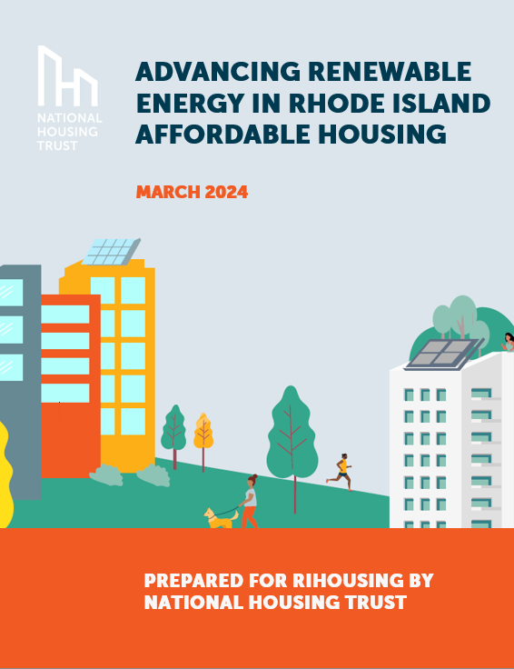
RIHOUSING RENEWABLE ENERGY REPORT
Renewable energy incentive programs should include adders that promote affordable housing participation and ensure that low-income residents receive the benefits of renewable energy.
Amend the master meter ban to exempt affordable housing providers pursuing renewable energy.
Invest in resources and programming to provide in-depth technical assistance for affordable housing providers interested in deploying on-site renewable energy.

Slide 10
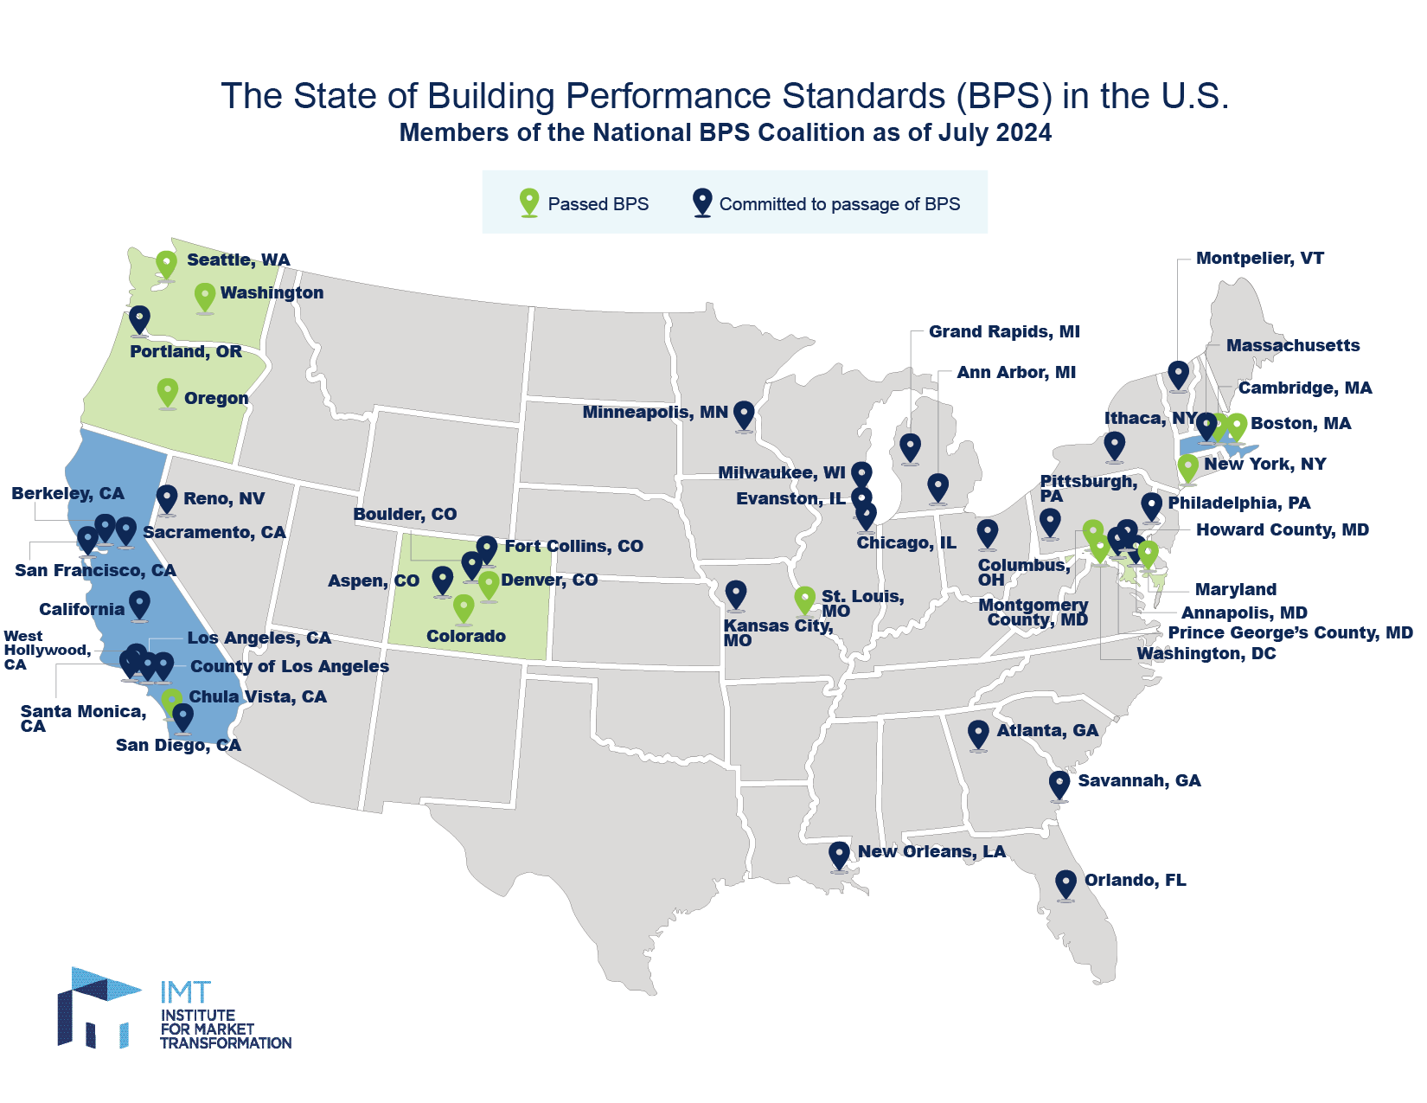
BUILDING PERFORMANCE STANDARDS (BPS)
A BPS requires buildings to meet carbon or energy performance targets by specific deadlines with fines for non-compliance.
E.g., In Maryland, MF and commercial bldgs. larger than 35K sq. ft. must reduce GHG emissions by 20% before 2030 and emit no onsite emissions by 2045.

Slide 11
BPS ACCOMODATIONS FOR AFFORDABLE HOUSING
Most BPS do not exempt affordable housing, but provide flexibility to address challenges
Extended compliance timeline to align with the property refinancing cycle
Adjust the performance target
Reduce or waive non-compliance penalties
Consider restrictions on accessing debt and/or property reserves as evidence of financial hardship
Delay the compliance start date for affordable housing
EXAMPLES
Seattle:
Exempts affordable housing from meeting interim compliance targets for the first 2 of 4 compliance cycles. Still requires affordable housing to achieve net-zero emissions by the last cycle.
Wash, D.C.:
Developed financial distress criteria specific to affordable housing that providers can use to justify the need for a compliance delay.

Slide 12
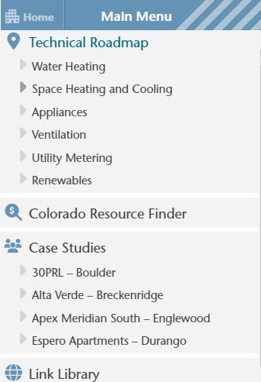
COLORADO ELECTRIFICATION HUB
QAP: “The most competitive response to achieving a higher level of energy efficiency is a highly efficient, all-electric project certifying to a program requiring net zero carbon emission or net zero carbon emissions ready.”
Colorado Multifamily Affordable Housing Electrification Hub
Equip affordable housing developers to incorporate electrification designs and elements in new construction and rehabilitation projects
Technical roadmap includes an overview of technology and design considerations for each electrification pathway
Searchable database of funding, financing, and incentive opportunities for multifamily affordable housing electrification
Support peer learning through case studies
https://multifamily-ehub.chfainfo.com/

Slide 13
SOLAR TECHNICAL ASSISTANCE PROGRAMS
Massachusetts STAR Program provides project management and technical assistance and financial assistance to affordable housing providers.
California SOMAH Program SOMAH Program offers comprehensive TA and coordination with other energy-related programs.
NYSERDA Affordable Solar & Storage Predevelopment & TA Program provides predevelopment assistance to affordable housing providers seeking to install solar that benefits LMI households.
NYC-HPD Solar Where Feasible helps affordable housing developers complete preliminary assessments of solar financial viability.
Connecticut Green Bank’s Solar Marketplace Assistance Program supports participants to solicit bids and arrange financing.

Slide 14
ELECTRIC INFRASTRUCTURE UPGRADES
CHALLENGES
Electrifying older multifamily buildings often requires utility service upgrades, including increasing electrical service and installing a higher-capacity transformer or new service lines from the street. Most or all costs could be borne by the customer if the upgrade is necessary due to clean energy building improvements. In D.C., costs for service upgrades vary from $4,000-$8,000 per housing unit.*
COLORADO CASE STUDY
The General Assembly passed legislation capping the cost charged to building owners for upgrading electric service at AFFORDABLE HOUSING to $300/residential unit.
The utility company can recover the costs above the cap through ratemaking.
Colorado House Bill 218
*Cost estimates based on what NHT sees for our portfolio in D.C.

Slide 15
THANK YOU

